Slide 1

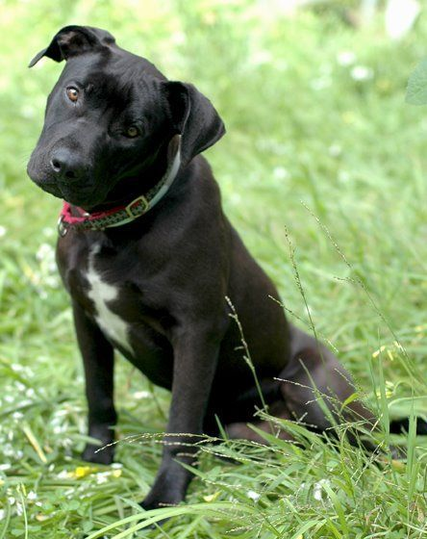
Welcome
Presented by Data and a Dream Team
Eve Birmingham & Sona Sibichan
February 6, 2024

Slide 2

2024
Booking Generation
Goal and Plan
Class: Information Systems for Business Intelligence
Industry: Landscape Care and Maintenance
Data Set: DM raw data Updated Pivot for Spring 2024

Slide 3

Introduction to Results Analysis
Goal: Maximize New Booking Generation in 2024
Key Question: What is the highest performing product/creative combination?
Importance: Results will be implemented in 2024 Booking Generation Increase Project.
Projected Outcome: Raise bookings by a minimum of 10%.

Slide 4


Evaluating Our Options
Products
Creatives
P1 - Fertilization, Seeding and Weed Plan
P2 - Lawn Mowing and Maintenance Plan
P3 - Mosquito Control Plan
P4 - Tick Control Plan
P5 - Tree and Shrub Service Plan
C1 - Direct Mail
C2 - Door to Door Promotion
C3 - Facebook/Instagram Paid Ads
C4 - Google Ads

Slide 5


First Looks
P5 – Tree & Shrub Service Plan
Using C3 – Facebook Paid Ads:
Highest Conversion Rate 1.5%
Lowest sample size of test 2%
P5 – Tree & Shrub Service Plan:
Highest Conversion Rate 1.3%
Lowest sample size of test 14%
FICO Score Distribution
<750 – 100%

Slide 6
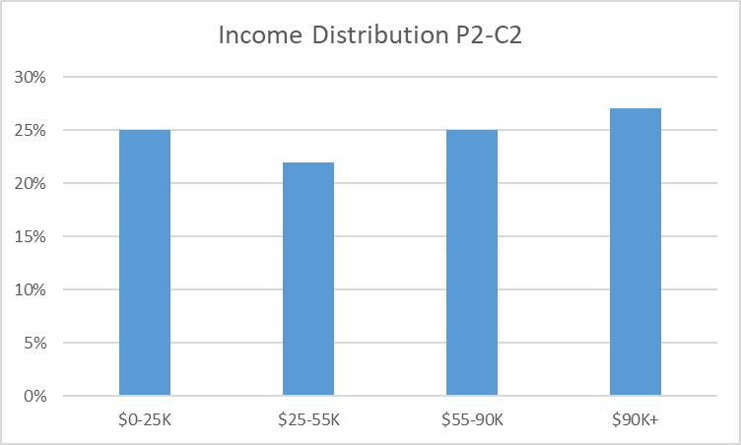
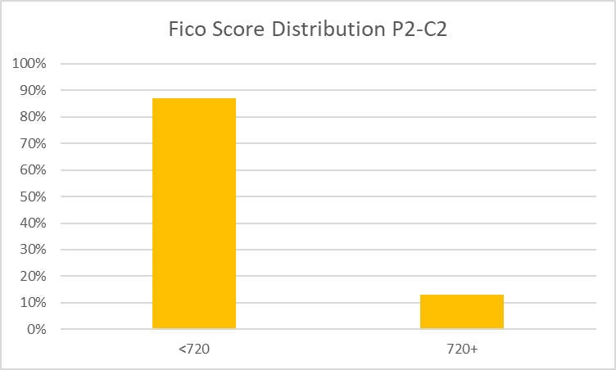
1.3%
Second Highest Conversion

Slide 7

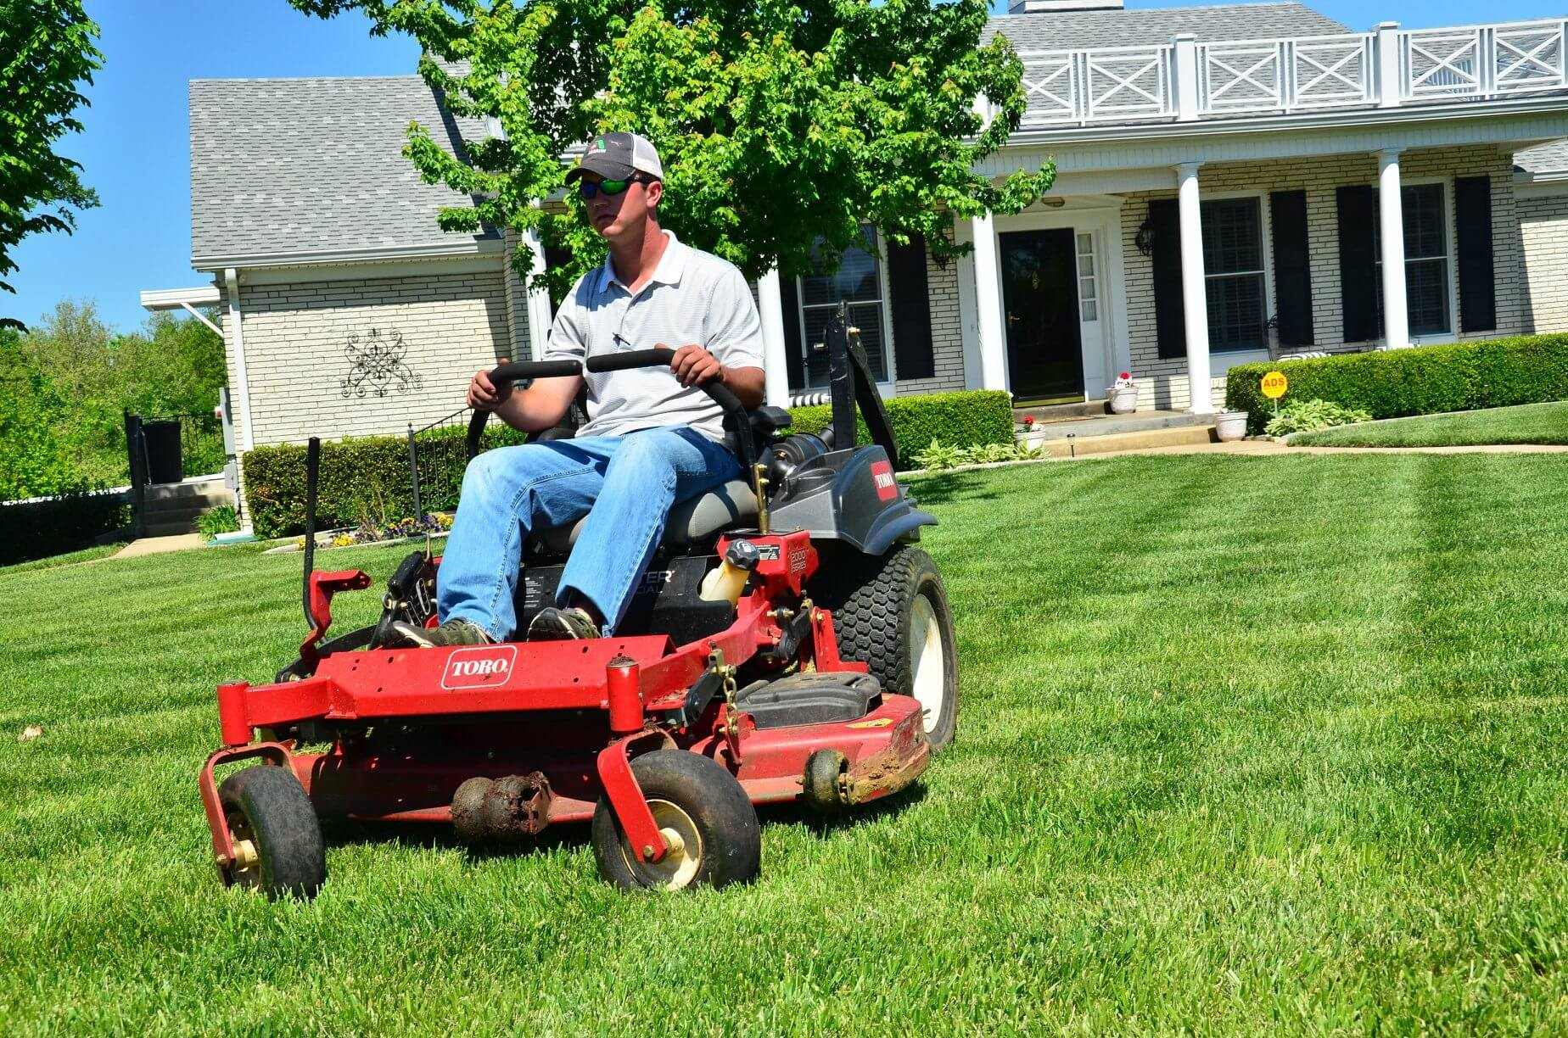
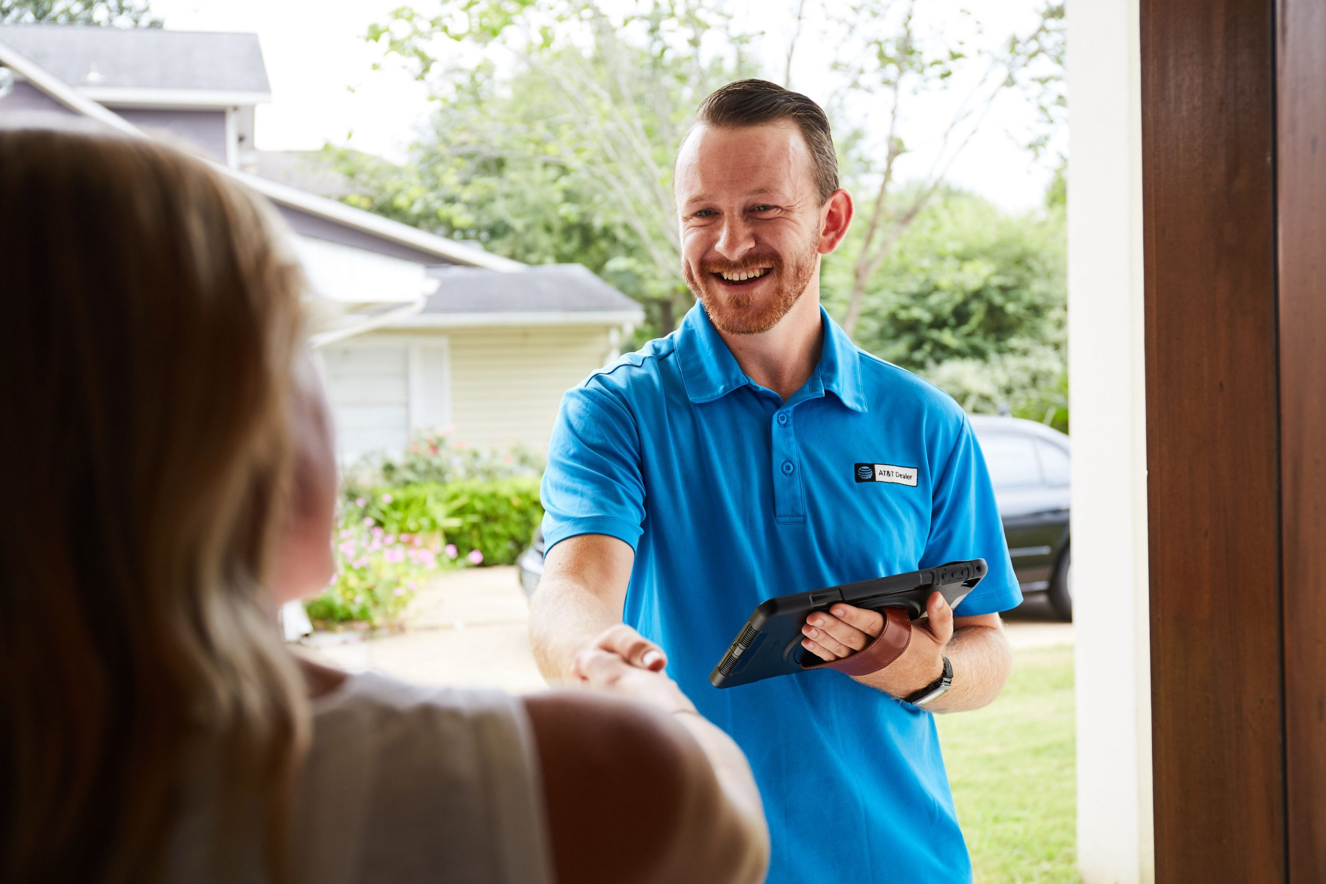

Winning Combination
&
P2: Lawn Mowing & Maintenance Plan
C2: Door to Door Promotion

Slide 8
KEY INSIGHTS
Services are Month to Month so sales increase per month, so income & credit are essential for success of our plans
10,000 Prospects x 1.3% Conversion rate = 130 Booked Service Plans
Month 1 - 130 New Sales @ $125 each = $16,250 $16,250
130 New Sales @ $125 each = $16,250
Month 2 plus $32,500
- 130 Sales from Month 1 @$125 each - $16,250
- 130 New Sales @ $125 each = $16,250
plus
Month 3 - 130 Sales from Month 1 @$125 each - $16,250 $48,750
plus
- 130 Sales from Month 2 @$125 each - $16,250

Slide 9

Risk Assessment
How do we compare the data?

Slide 10

Bowl of Fruit

Slide 11


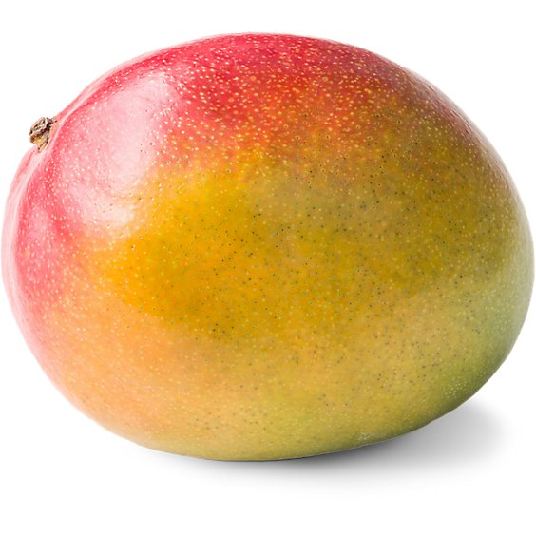







Slide 12
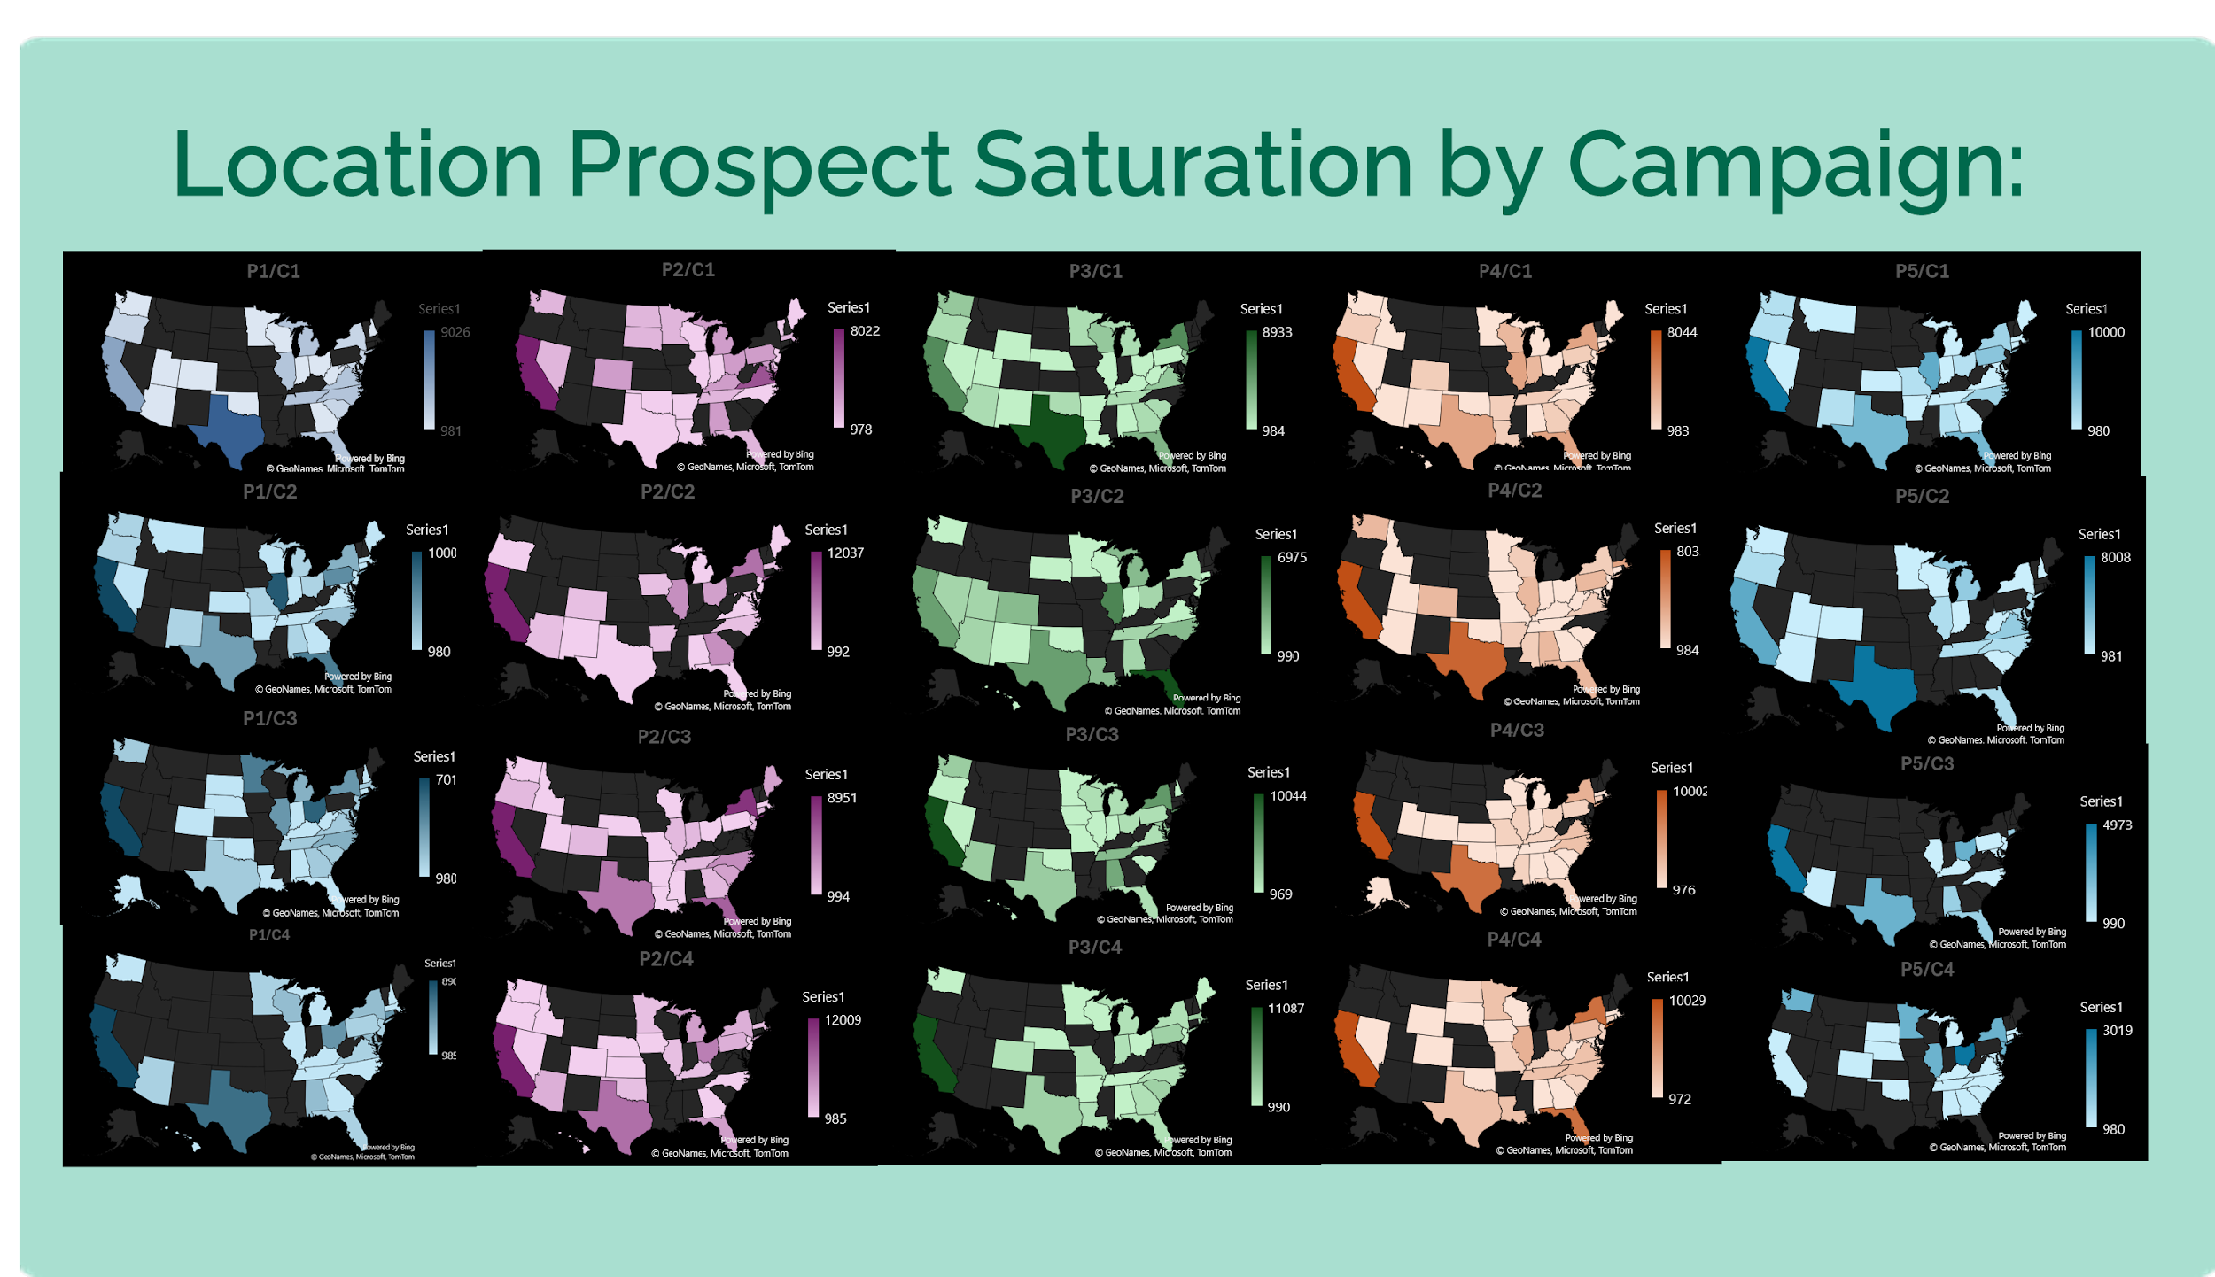
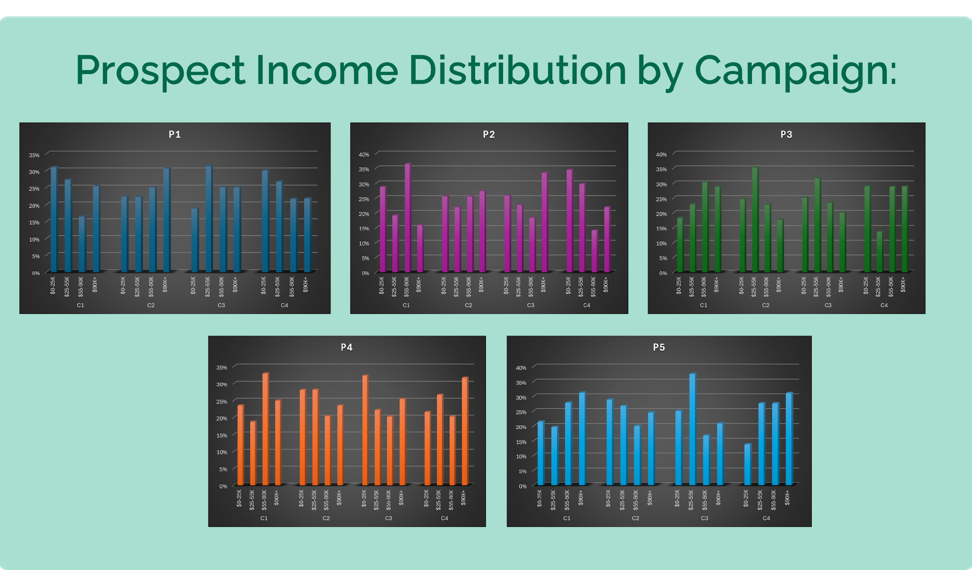
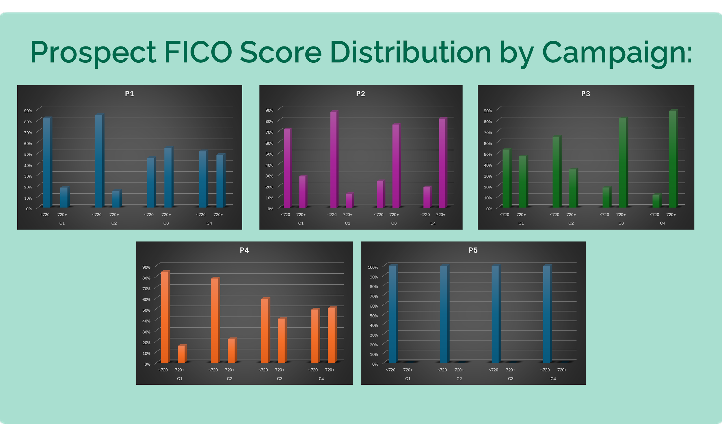

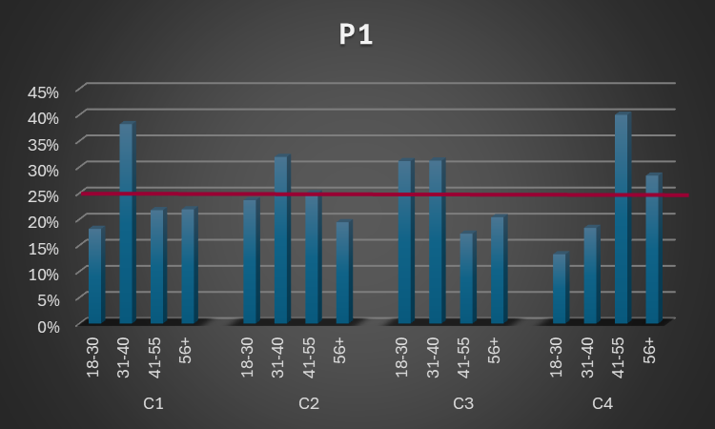
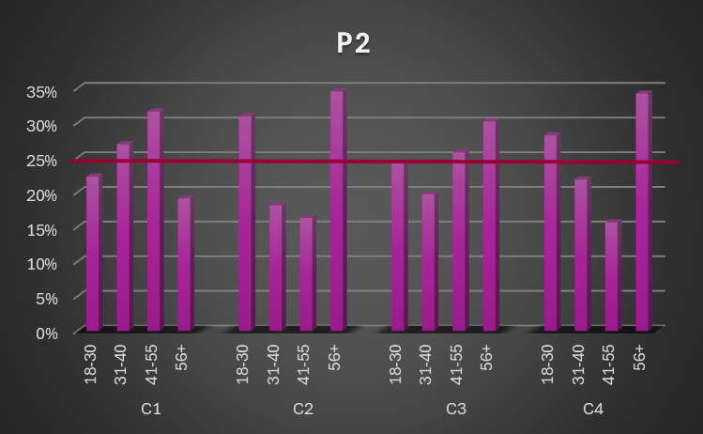
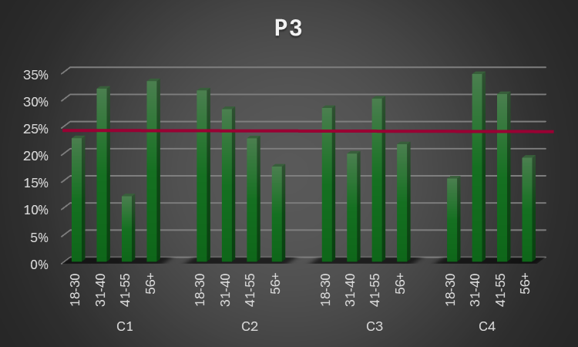
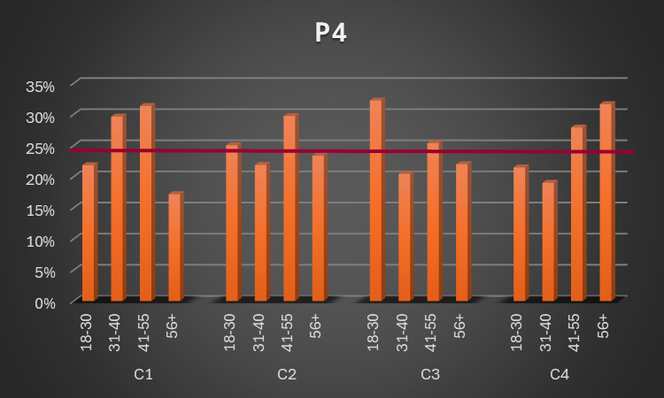
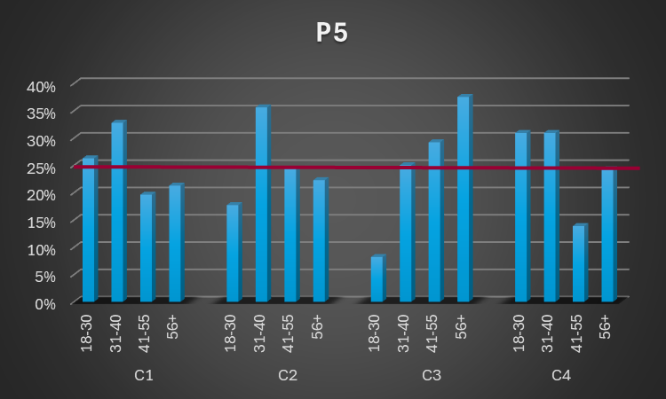
Prospect Age Distribution by Campaign:

Slide 13

Action: Recommendations
& Next Steps
1) Define our target audience
2) Choose matching test groups and run the initial test again
3) Revaluate test data after 30 days
4) Set up another data analysis meeting
5) Select the winning promotion
and implement to maximize booking

Slide 14

Any Questions

Slide 15

Thank you very much!

